Slide 1




Databricks
Data & Automation Line Up 2024
Notes:
Change the title with the technology title
During the session mention people can ask questions in the chat

Slide 2





About Rockfeather
At Rockfeather, we're not just consultants; we're dream builders. We turn your Data & Automation vision into reality, using the power of technology to bring your ideas to new heights. Working hand-in-hand with you, we empower you to achieve your goals. Ready to see your solid ideas take flight? Partner with Rockfeather today, and let's start a journey of innovation and success. Together, there's no limit to what we can achieve.
Notes:
Default slide, don’t adjust
Storyline; this is what we do at Rockfeather, we offer different data & automation related services, and our mission is to bring your solid ideas to life

Slide 3

Our techologies
Tableau
Power BI
Azure Data Factory
TimeXtender
DBT
Power Apps
Azure Logic Apps
Azure ML
Databricks
Outsystems
Acterys
Alteryx
Power Automate
Process Science
Python
Airbyte
Notes:
Default slide, don’t adjust
Storyline; we use best of breath technologies on all domains
You can highlight some relevant for your story

Slide 4
The problem
Scalability Issues - Traditional data processing systems often struggle to scale efficiently, which can lead to increased costs and complexity as data volume grows
Complex Data Pipelines - Managing complex data pipelines involving multiple stages of processing, from ingestion to visualization, is cumbersome and error-prone.
Data Quality Issues - Ensuring data quality and consistency across large datasets and different data sources is a significant challenge in data engineering.
Real-Time Data Processing - Many industries require real-time data processing capabilities to make timely decisions, which is challenging with traditional batch processing methods.
Machine Learning Integration - Integrating machine learning models into data pipelines is often complex and requires extensive setup.
Cost Management- Managing and optimizing costs of big data platforms can be difficult, especially when dealing with unpredictable workloads.
Notes:
Insert picture which describes a business problem your solution gives an answer to. So let’s say technology is Tableau. Describe the need for more and more companies to be able to work with dashboards and create visual insights. Being able to process a lot of data is more and more a competitive advantage and a key factor for companies to move forward and make a difference in this competitive world

Slide 5
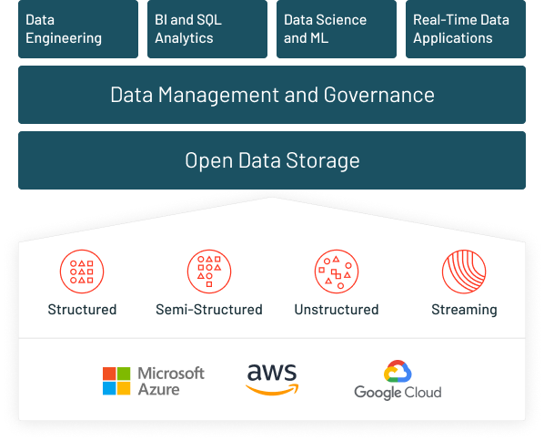
Solution & key features of Databricks
Scalability Issues: Leverages Apache Spark's distributed computing model, allowing data engineers to scale their data processing tasks horizontally across multiple nodes. Databricks' managed service also automates scalability, making it seamless and cost-effective.
Complex Data Pipelines: Offers a unified platform for all steps of the data pipeline. This integration reduces complexity and improves reliability. The platform includes native connectors and integrations with various data sources and sinks.
Data Quality Issues: Provides robust data governance tools and Delta Lake for ACID transactions and schema enforcement, which help maintain data integrity and quality.
Notes:
Insert picture which describes why this technology is a solution to that problem. Also insert about 3 bullets with key features of your technology

Slide 6
Solution & key features of Databricks
Real-Time Data Processing: Supports real-time data streams processing using Structured Streaming integrated with Apache Spark. This allows for efficient and scalable real-time analytics.
Machine Learning Integration: Offers MLflow, a platform to manage the ML lifecycle, including experiment tracking, model versioning, and deployment. Databricks also facilitates collaborative ML model building with its collaborative notebooks.
Cost Management: Provides fine-grained control over resource allocation with the possibility to choose between different types of compute resources based on workload needs. Auto-scaling and spot instance usage can significantly reduce costs.
Notes:
Insert picture which describes why this technology is a solution to that problem. Also insert about 3 bullets with key features of your technology

Slide 7
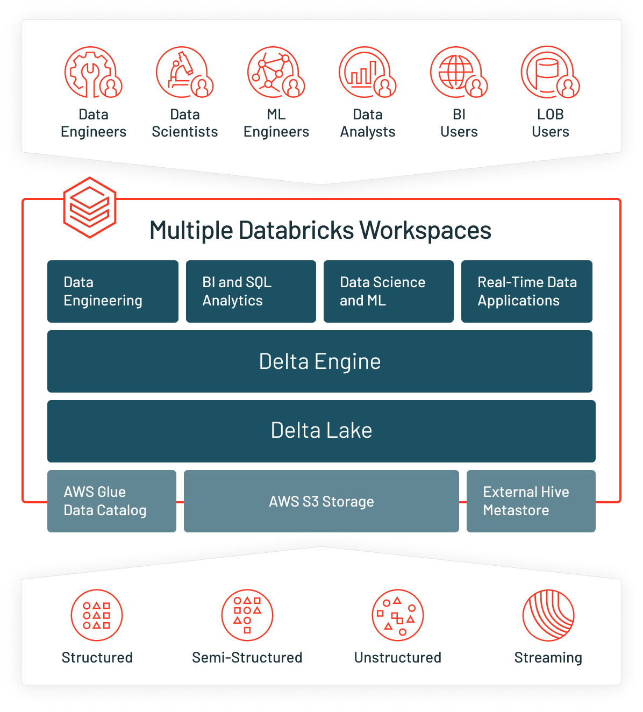
Benefits
Unified Analytics Platform:
  Databricks provides a single platform where data engineers can perform data exploration, prototyping, and production tasks all in one place. This reduces the need for multiple tools and simplifies the data pipeline.
Performance Optimization:
  Built on Apache Spark, Databricks optimizes query execution automatically, enabling faster data processing even with massive datasets.
Collaborative Environment:
  Databricks' collaborative notebooks support Python, Scala, SQL, and R, allowing team members with different expertise to work together seamlessly.
Scalability and Flexibility:
  Easily scalable both vertically and horizontally, Databricks adjusts to varying workload demands without manual intervention, supporting both cloud and hybrid environments.
Advanced Analytics Capabilities:
  Integrates with machine learning frameworks and offers tools like MLflow for managing the entire machine learning lifecycle from experimentation to production. Also offers Dashboarding capabilities.
Delta lake integration:
  Ensures data reliability and consistency with Delta Lake, which offers ACID transactions and scalable metadata handling.
  Supports time travel, enabling users to access and revert to previous versions of data
Notes:
Describe some key benefits of the tool, this can be bullets, this can also be a picture which you use to describe the benefits of technology X

Slide 8
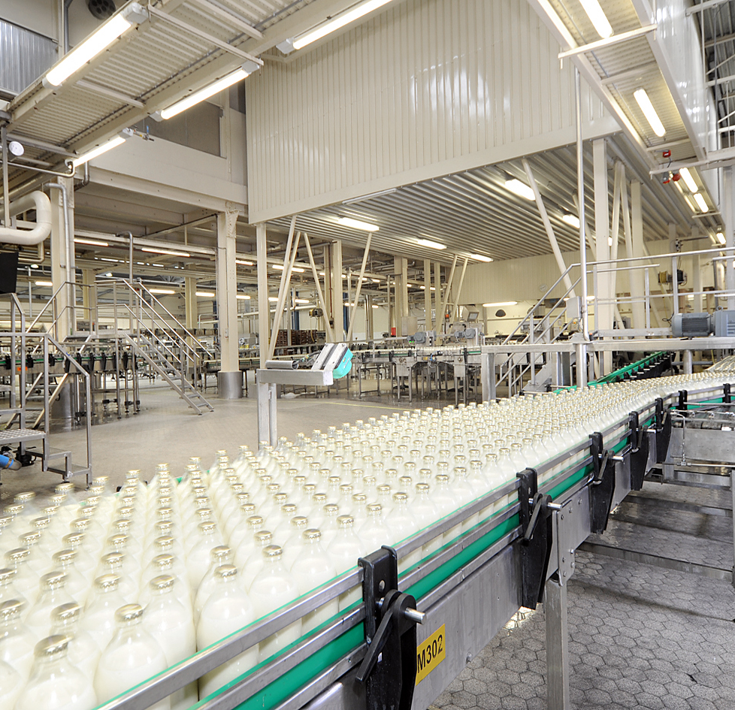

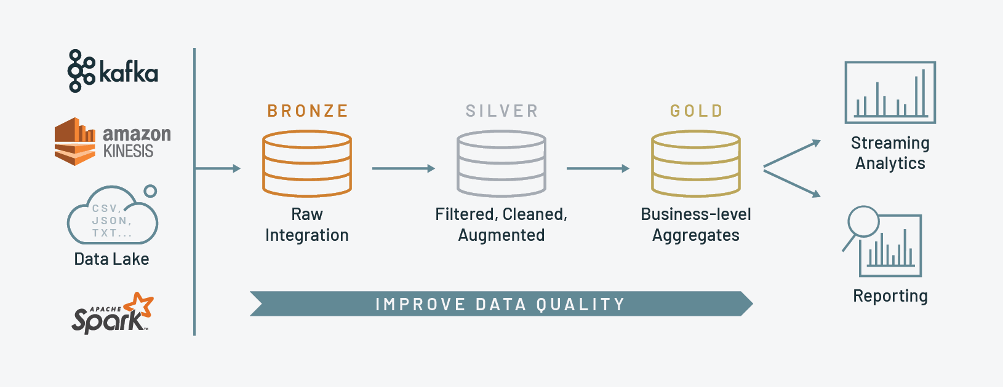

USE CASE - RETAIL STORE
ETL use case that demonstrates data transformation through bronze, silver, and gold layers in Databricks. This scenario involves data from various sources like sales transactions, customer information, product inventory, and supplier details. The goal is to cleanse, aggregate, and summarize this data for actionable insights and reporting.
Notes:
SHOW AN USE CASE, PLEASE LOOK AT SOME EXAMPLES ON SLIDEHUB
Use 3-4 bullets to describe WHAT we did a client, so for example; “we used Power BI to bring financial reporting to a new level”

Slide 9
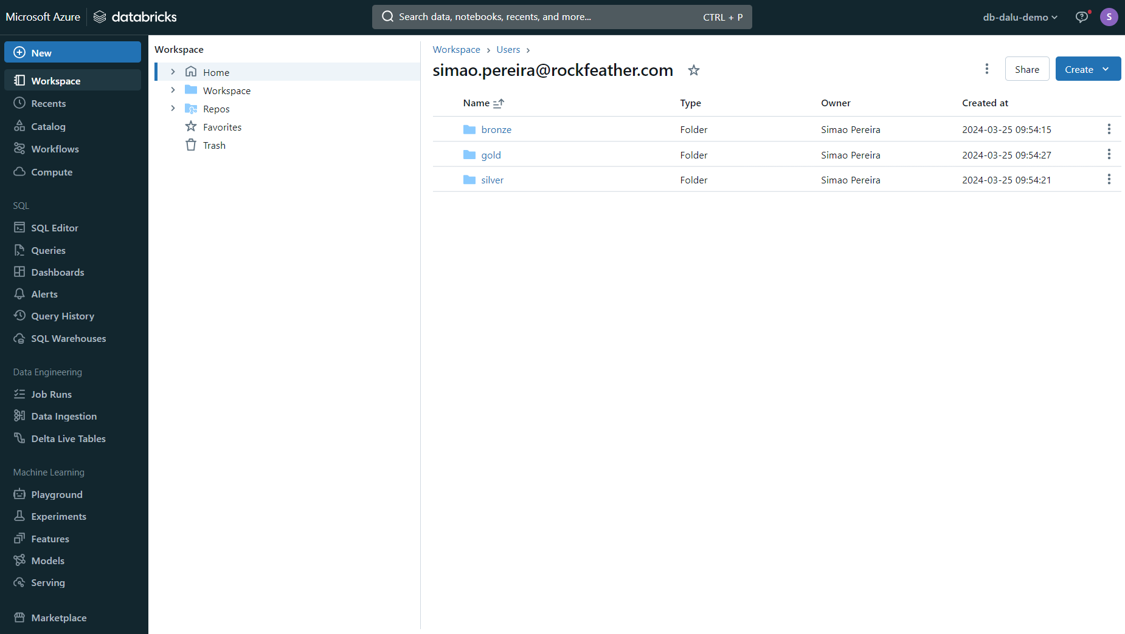
Databricks- Demo
Notes:
Show a quick demo of the tool, max 5 mins!!! (the demo video is also available so you can refer people to that as well). So use the time to quickly highlight some key features

Slide 10
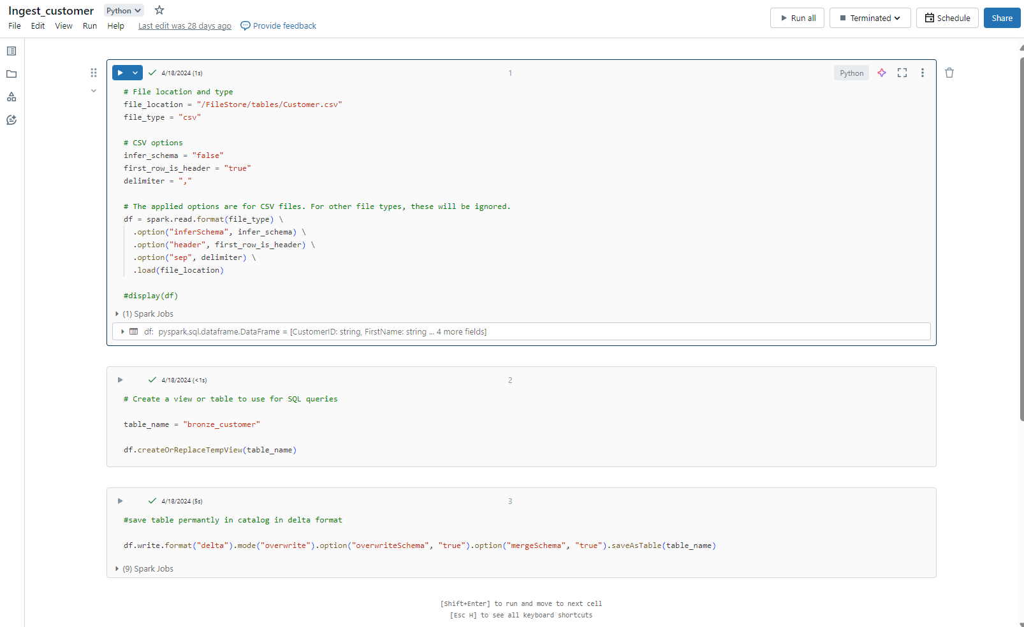
Databricks- Demo
Notes:
Show a quick demo of the tool, max 5 mins!!! (the demo video is also available so you can refer people to that as well). So use the time to quickly highlight some key features

Slide 11
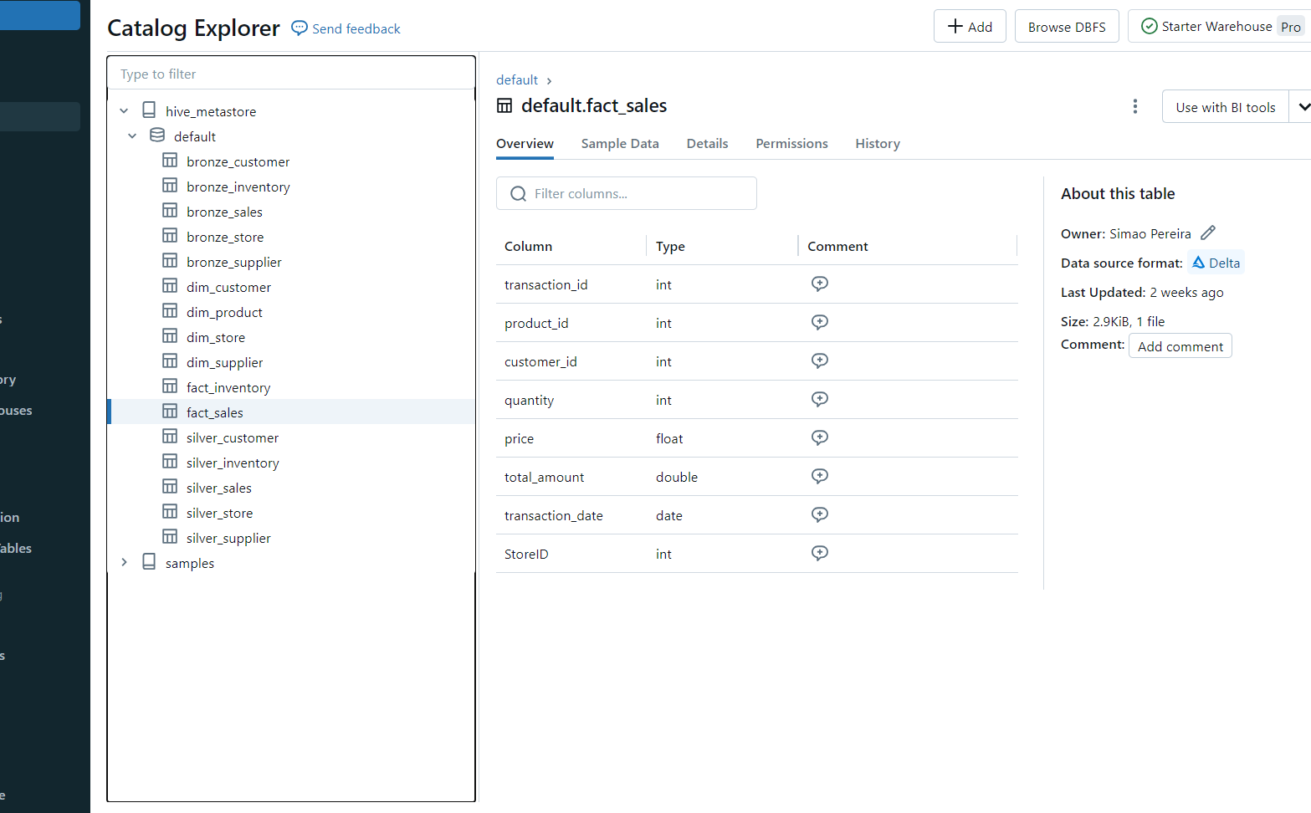
Databricks - Demo

Slide 12
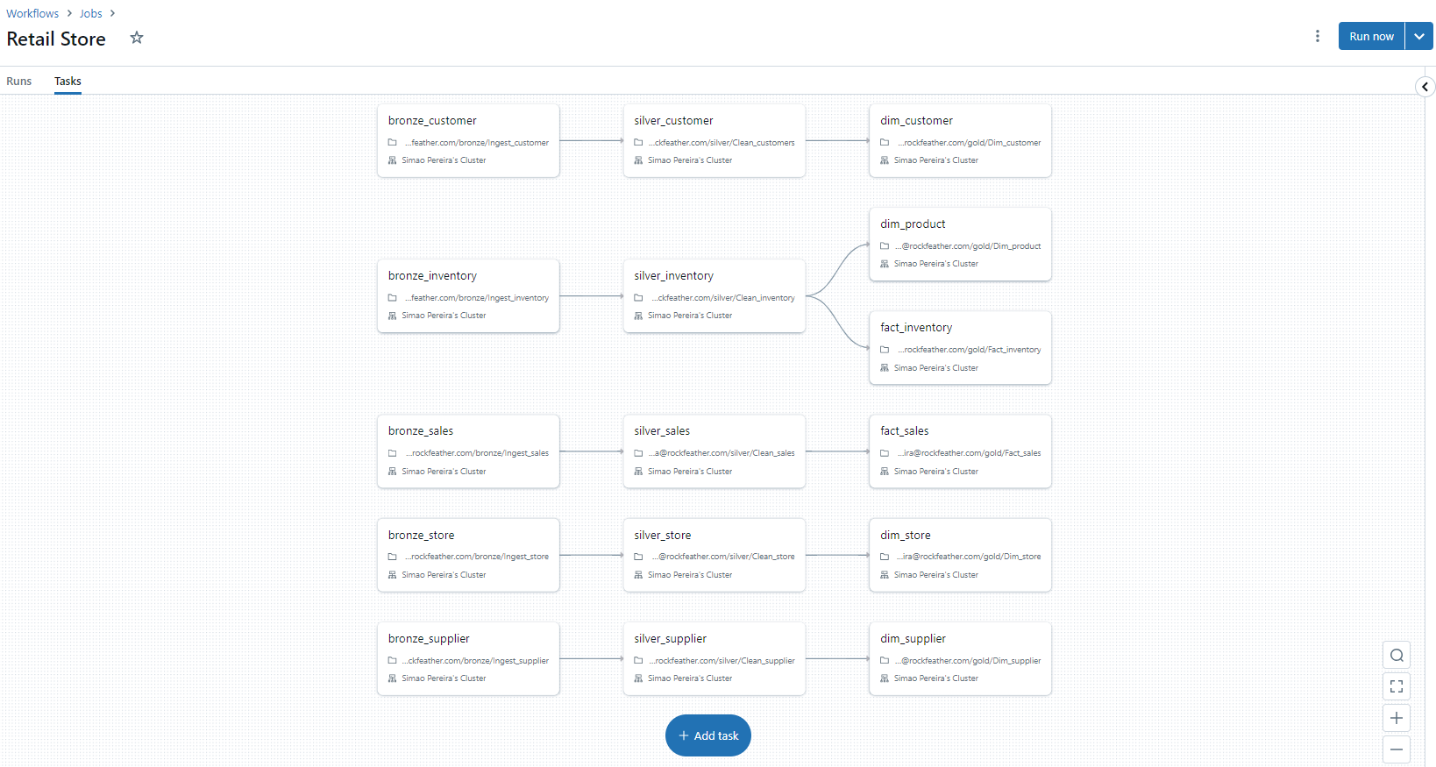
Databricks - Demo

Slide 13
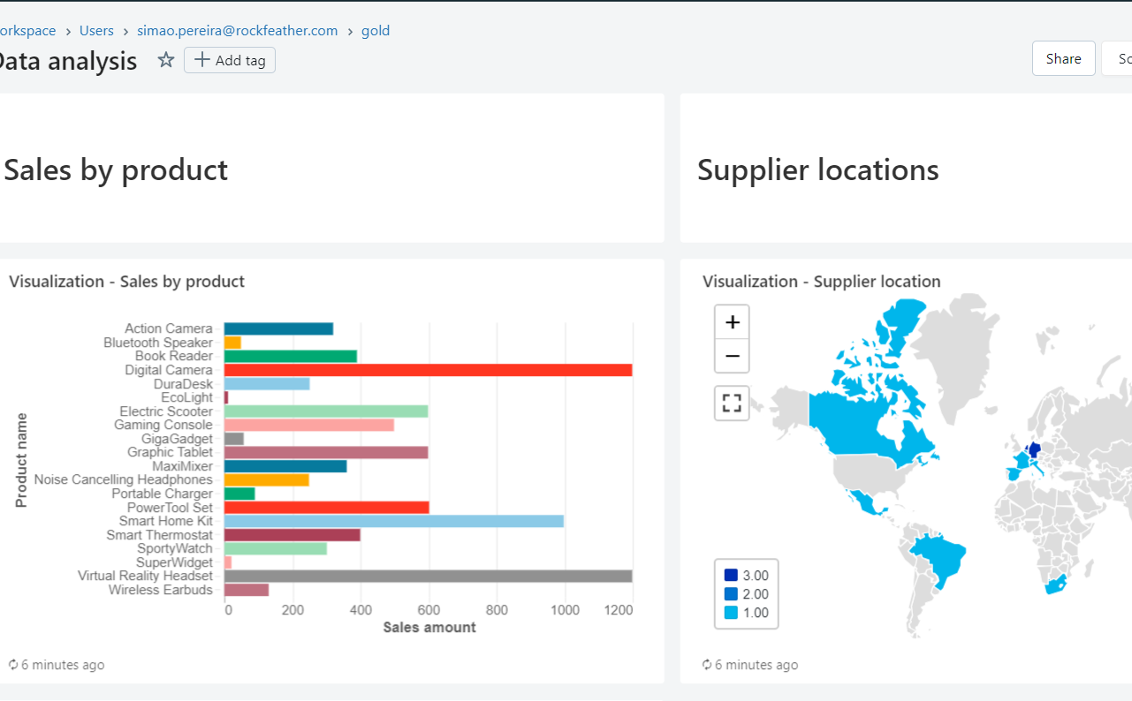
Databricks - Demo

Slide 14


Contact details
Simao Pereira
simao.pereira@rockfeather.com

