Slide 1




Airbyte
Data & Automation Line Up 2024
Notes:
Change the title with the technology title
During the session mention people can ask questions in the chat

Slide 2





About Rockfeather
At Rockfeather, we're not just consultants; we're dream builders. We turn your Data & Automation vision into reality, using the power of technology to bring your ideas to new heights. Working hand-in-hand with you, we empower you to achieve your goals. Ready to see your solid ideas take flight? Partner with Rockfeather today, and let's start a journey of innovation and success. Together, there's no limit to what we can achieve.
Notes:
Default slide, don’t adjust
Storyline; this is what we do at Rockfeather, we offer different data & automation related services, and our mission is to bring your solid ideas to life

Slide 3

Our techologies
Tableau
Power BI
Azure Data Factory
TimeXtender
DBT
Power Apps
Azure Logic Apps
Azure ML
Databricks
Outsystems
Acterys
Alteryx
Power Automate
Process Science
Python
Airbyte
Notes:
Default slide, don’t adjust
Storyline; we use best of breath technologies on all domains
You can highlight some relevant for your story

Slide 4



The problem
Source
Extract Load
Transform
Production
D
E
D
E
DATA
Integrations
Structured
Semi Structured
Unstructured
BATCH
Hourly / Daily
BRONZE
(RAW)
Staging
SILVER
(CORE)
Cleaning
Standardize
Normalize
Historic
GOLD
(SERVE)
Data Marts
Aggregate
Denormalize
DATA VIZ
D
V
PROCES MINING
STREAMING
Realtime
P
M
DATA SCIENCE
D
S
D
E
REVERSE ETL
Hourly / Daily
LOW CODE
LOW CODE
L
C
L
C
EPM
ORCHESTRATION / GOVERNANCE / DATA QUALITY / DATA CATALOG

Slide 5







The problem
DATA SOURCES
EXTRACT DATA
DATA STAGING
MODERN DATA WAREHOUSE
SEMANTIC MODEL
REPORTING
Local DWH
Local
Files
Azure Data Factory (ADF)
Other Sources
Azure SQL Database
Azure SQL Database
Powe BI Local Model
Other Sources
Other Sources

Slide 6

The solution
DATA SOURCES
EXTRACT DATA
DATA STAGING
MODERN DATA WAREHOUSE
SEMANTIC MODEL
REPORTING
Local DWH
Local
Files
Other Sources
( )
Azure SQL Database
Azure SQL Database
Powe BI Local Model
Other Sources
Other Sources

Slide 7
Solution & key features
300+ built-in connectors
Custom connectors
Clean and transform your data with DBT
DATA SOURCES
EXTRACT DATA
Local DWH
Local
Files
Other Sources
( )
Other Sources
Other Sources
Notes:
Insert picture which describes why this technology is a solution to that problem. Also insert about 3 bullets with key features of your technology

Slide 8
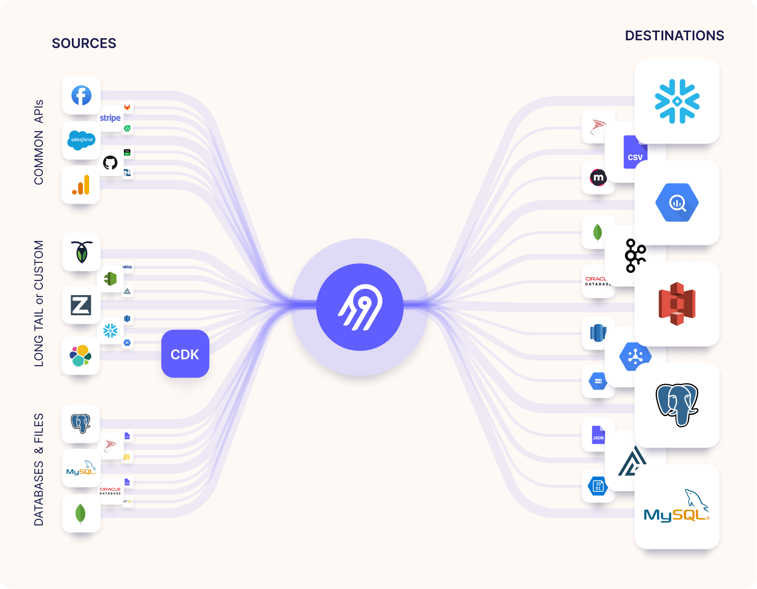
Benefits
Plug-in data extractions and destinations
Smooth maintenance and monitoring of your data extractions
Simplify your data pipeline
Notes:
Describe some key benefits of the tool, this can be bullets, this can also be a picture which you use to describe the benefits of technology X

Slide 9
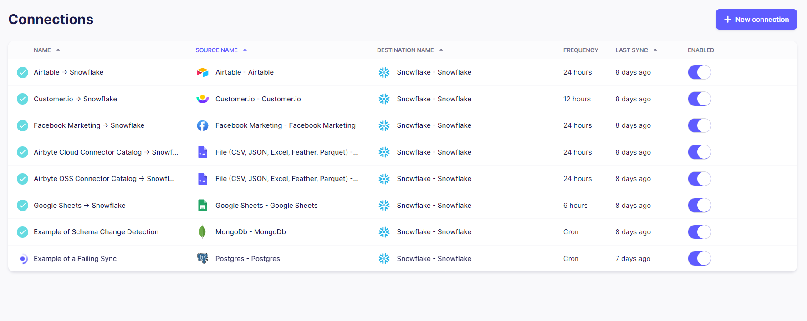
Airbyte - demo
Notes:
Show a quick demo of the tool, max 5 mins!!! (the demo video is also available so you can refer people to that as well). So use the time to quickly highlight some key features

Slide 10



Contact details
Alexandra Feldman
alexandra.feldman@rockfeather.com

